Slide 1
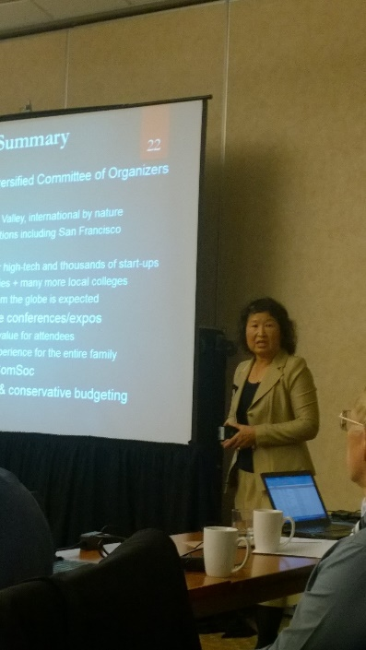
Tutorial Program Description
Title:
Advanced Writing and Presentation for English-as-a-Second-Language Engineers
● Time:
Feb, 17 , 2016 Am9:00-12:00 Pm14:00-16:00( Individual tutoring sessions )
● Place:
Coference Room 3F in Administrative Building at NCU(行政大樓三樓會議室)
Abstract:
Technical writing and presentation for an engineer whose native language is not English can be harder than the technical expertise the engineer attempts to convey. Without the proper communication skills in English, technical contributions could be drastically discounted and dismissed within the international technical community. Beyond the known English grammar and common language usage, key factors are explained to overcome cultural difference, logic inference and body language diversity.
This Tutorial will high-light English awkwardness in a case-by-case approach based on excerpts of reviewed papers from submissions to many known International conferences. Corrections are made about the English errors, which happen more often than one would expect, even among reputable/experienced engineers. Reconstruction in more authentic American English style will also be demonstrated.
Individual tutoring sessions can be made available for the first few attendees who sign up through the University Center registration. Bring your paper or journal samples to the instructor for personalized guidance and continuous improvements.
Instructor:
Dr. Narisa Nan Chu, Co-founder, CWLab Int'l., Thousand Oaks, CA, USA, email: narisa.chu@ieee.org

Slide 2
Instructor’s Brief Biography
Dr. Narisa Chu, 朱 南 玉, worked in AT&T Bell Labs, Rockwell International, Tellabs International, Comcast/Motorola/Verizon and Thomson Multimedia, started as Senior Member of Technical Staff and promoted through the ranks to Executive Program Manager of Advanced Technology, Product Development and Service Deployment. Her technical contributions have followed the transformation from digital voice, Internet data, to the recent digital video distribution and processing, where she was involved in encryption, conditional access, digital rights management, Intellectual Property protection as well as content processing and user interface.
While heavily engaged with the telecom industry, Dr. Chu has forged collaboration with the academia by grant management and adjunct teaching in University of Illinois - Chicago, Widener University - Philadelphia, California Lutheran University - Thousand Oaks, and DeVry University on multiple campuses. She was also the Director of Research & Services at California State University – Northridge. She has started 2 companies and currently is the principal of CWLab International, among other entrepreneurial activities throughout Chicago, Southern California and Asia.
She has published more than 50 papers in areas related to digital communication/networking technology evolutions, and edited 2 books. She has been credited as the co-author of Digital Set-top Box Standards in SCTE and CCITT Study Group 9 and received awards for the early digital cable conversion standardization. Her current interests in research and product development include social networking, cloud computing, data security, and Internet technology to eHealthcare, concentrating on brain communication interfaces.
Dr. Chu has volunteered in IEEE professional services since the 1980’s, serving as Board of Governors in Consumer Electronics Society, Executive Industry Chairs for GLOBECOM, IGIC, and many other Communications/Computer Society conferences and local Chapters.
She received her B.S. from National Tsing Hua University, M.S. from Iowa State University, and Ph.D. from Northwestern University, major in Nuclear Engineering, in 1972, 1973, and 1977, respectively. Her career in the nuclear industry was short-lived. Her career in Telecommunications and Networking Software Systems has thrived for 30 years and continued till today.

